Slide 1

Data Science Project for General Assembly DAT 13 Nico Salanio 2019
Background
Problem Statement
Solution & Methodology
Data Source
Algorithm – Linear Regression
Results

Slide 2

Background
NBA Fantasy is a simulated tournament whereby the objective is to win by having the highest probability of winning based on statistics
Each team consists of 12 players and only 8 are allowed to be fielded each time or game
The 8 statistics by which players are measured are:
Field Goal %
Free Throw %
# of points made
# of 3 pointers made
# of assists
# of steals
Lowest # turnovers
# of rebounds

Slide 3

Problem Statement
How do we pick the best players in each position for next season’s Fantasy Draft in order to have good chance of winning the tournament?

Slide 4
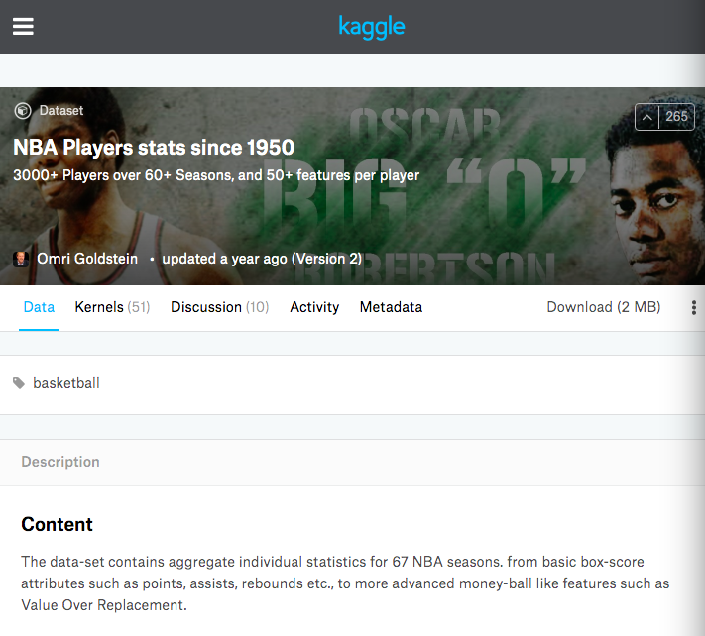
Solution & Methodology
Pick the best players by statistics by position (5 slots)
Point Guard
Shooting Guard
Small Forward
Power Forward
Center
Pick the next 5 slots with the same positons above
Pick the next 2 slots regardless of position to complete 12 slots.
NBA statistics were sourced from a contributor from Kaggle (stats from every player from 1950 – 2017)

Slide 5
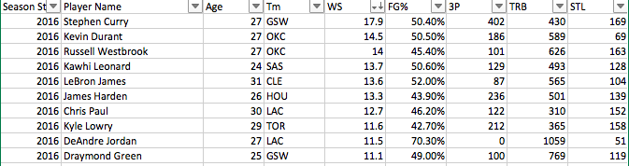
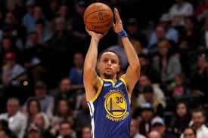
Data Structure
Dataset was downloaded in CSV format included all the needed statistics
An index statistic called Winning Share (WS) is also included which is a derivation of a combination of the most important statistics to measure how productive a player is contributing to his team winning
The best players have the highest WS
Eg: Steph Curry has the highest at 17.9 from the 2016 season
Filtered by at least 20 games played

Slide 6
Linear Regression
2016 stats as the training & test data
Filter the data to at least 20 games played to weed outliers
WS or Winning Shre being the Target Statistic
Train and Test the algorithm for only to include players who play a particular position (G, SG, SF, PF, C) to fill the 10 slots
For the remaining 2 slots, use all players since any position can be used to fill.

Slide 7
Testing the RMSE between different features (FEATURE SET 1 SELECTED BEING THE LOWEST RMSE AT 1.47)
FEATURE SET 1
Field Goal Percentage (FGPer), # of 3 pointers (3PT), # of Steals (STL) & # of Rebounds (TRB) = 1.47
FEATURE SET 2
Field Goal Percentage (FGPer), # of Steals (STL) & # of Rebounds (TRB) = 1.58
FEATURE SET 3
Field Goal Percentage (FGPer), # of 3 pointers (3PT), & # of Rebounds (TRB) = 1.50

Slide 8
Predicted 2017 Lineup: Top player picks for a winning team based on the features sorted from the highest: FGPer, 3PT, STL & TRB
First 5 Players
1. Point Guard : Stephen Curry
2. Shooting Guard: Klay Thomson
3. Small Forward: Paul George
4. Power Forward: Ryan Anderson
5. Center: Channing Frye
Next 5 Players:
1. Point Guard: James Harden
2. Shooting Guard: Eric Gordon
3. Small Forward: Trevor Ariza
4. Power Forward: Kevin Love
5. Center: Brook Lopez
Substitutions: Any 2 Players
1. Isaiah Thiomas
2. Kemba Walker

